Slide 1
Computational Properties of Neural Columns arising from Temporal Dynamics
Vincent Baker
Drexel University Department of Physics

Slide 2
Thesis
The big question: how does cognition arise from the biophysical organization of the brain?
Research question: Can columns of neurons encode time series inputs into high-order dynamic states that facilitate classification?
Research approach: Simulate neural columns in the liquid state machine computational model, measure the effects of physical properties on computational performance in classifying time series inputs

Slide 3
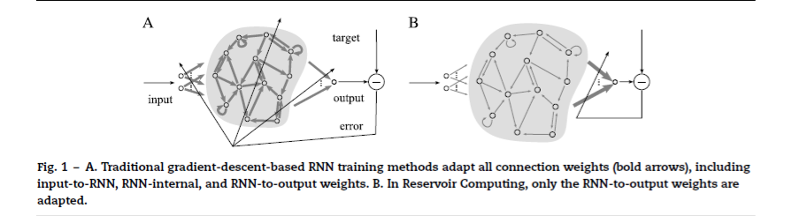
Liquid State Machines
Nonlinear “liquid” with fading memory is driven by an input
The input evokes complex dynamics in the liquid
A linear readout map extracts the desired data from the liquid
Multiple readouts can be trained with simple regression to extract different information from the same untrained liquid
Lukosevicius and Jaeger 2009

Slide 4
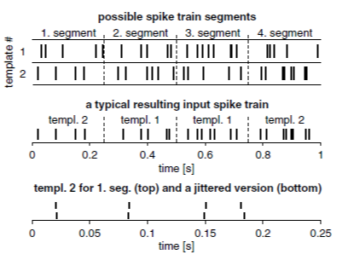
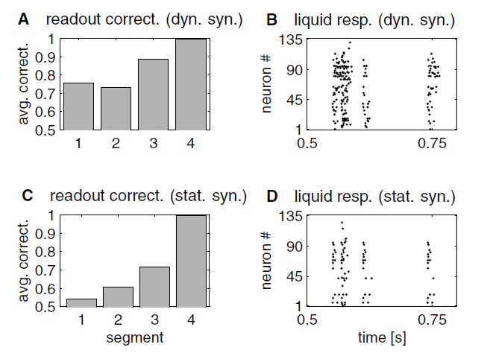
Fading memory
Maas et al showed that a reservoir with fading memory retains information about time history in its dynamic state
LSM was able to classify all 4 segments in a 1 second sequence based only on the liquid state at t=1 second
Maas2002 demonstrated that fading memory created by dynamic synapses (right, top) can recognize past events in a time series. The network with static synapses (right, bottom) showed limited memory.

Slide 5
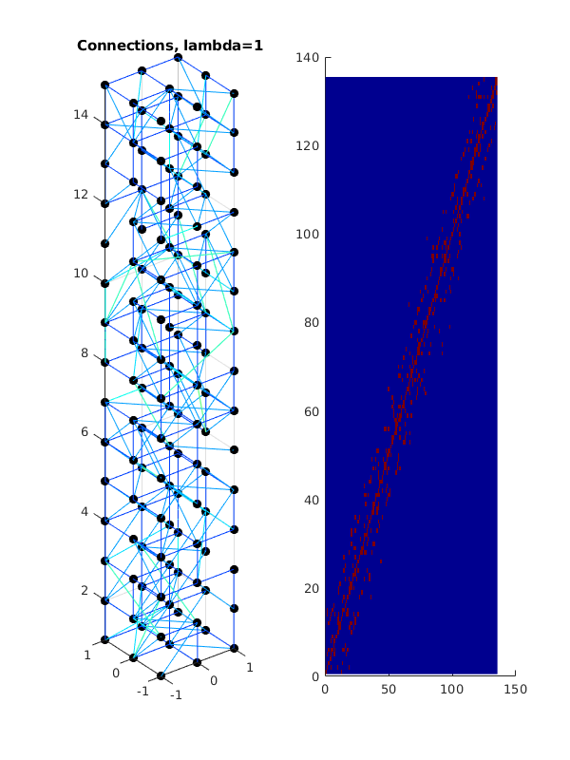
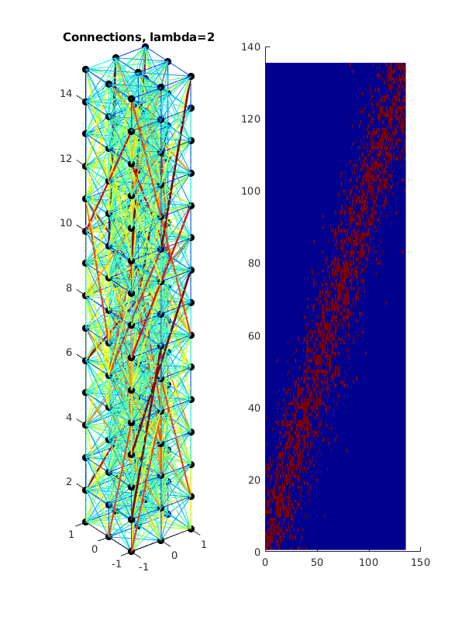
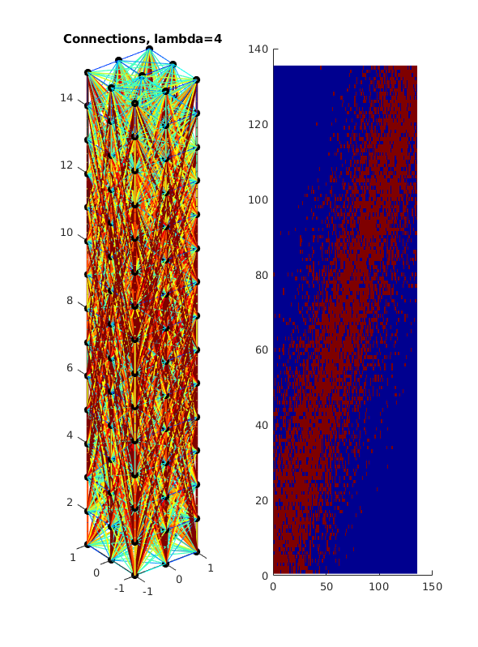
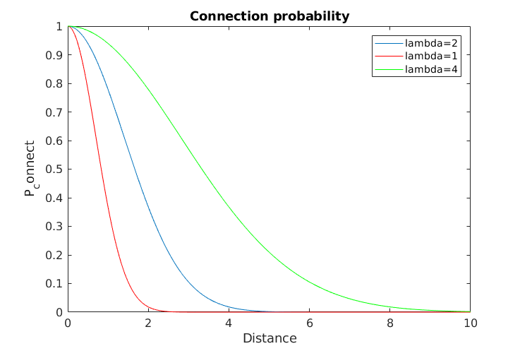
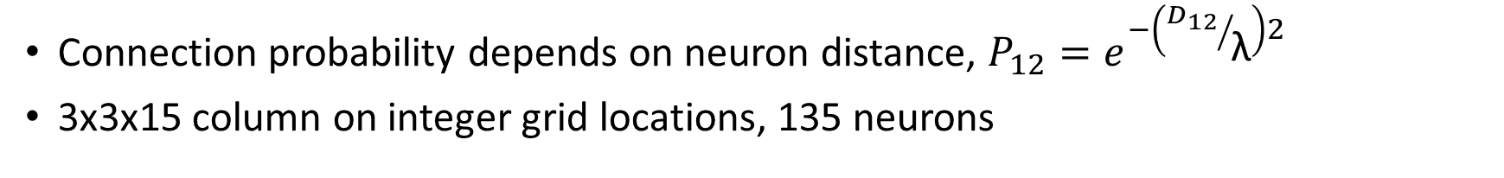
Neural connectivity
Connection probability depends on neuron distance, $P_{12}=e^{−\left({D_{12}}/{\text{λ}}\right)2}$
3x3x15 column on integer grid locations, 135 neurons

Slide 6
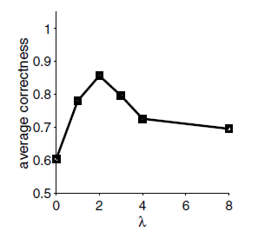
Neural connectivity
Original LSM paper (Maas 2002) found best performance for λ=2
This work will explore how spatial organization of the columns effect performance

Slide 7
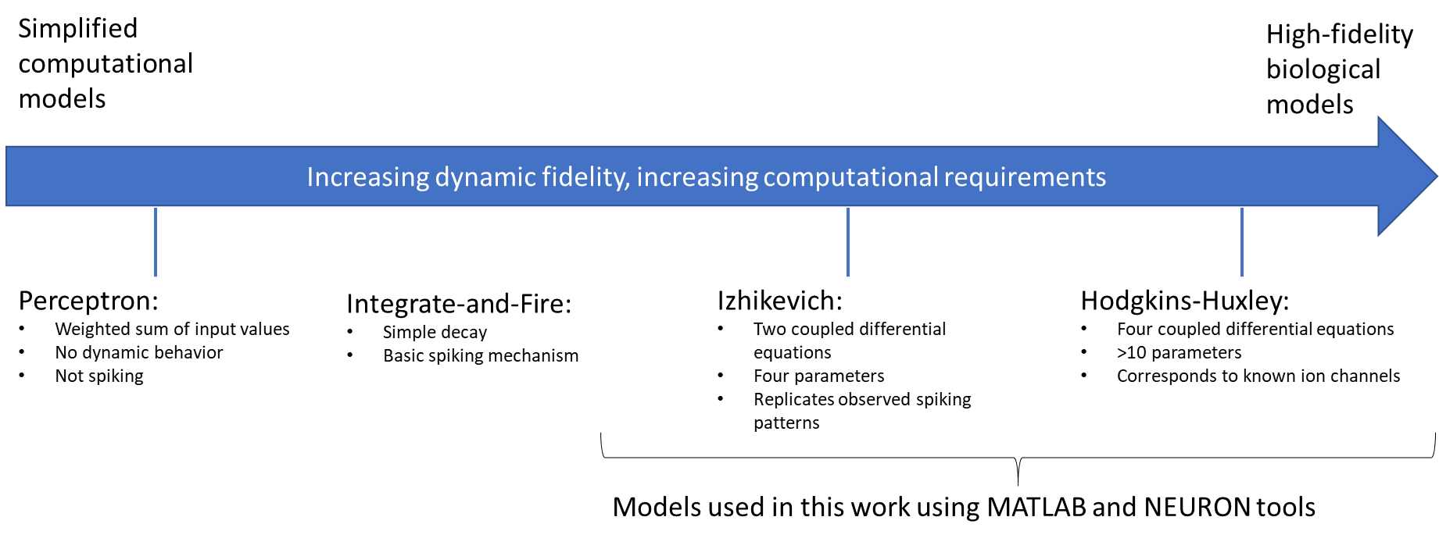
Neural models
Neural dynamics play an important role in temporal response
We start with the Izhikevich model, a simplified 2D dynamic system
Can explore nonlinear dynamics while retaining fast simulation

Slide 8
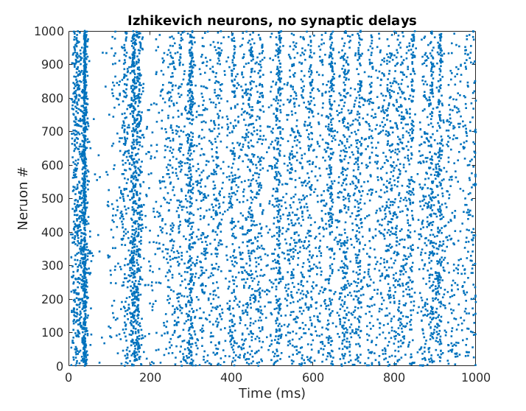
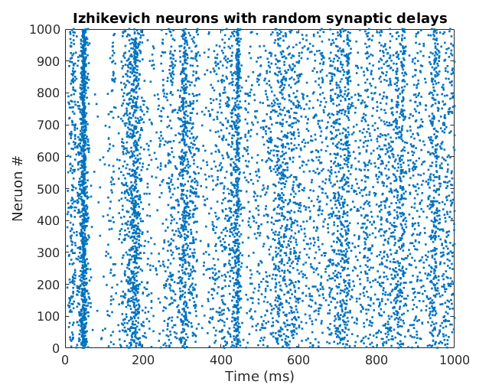
Neural models
Extended Izhikevich simulation to include propagation delay
Our model retains basic behavior of the Izhikevich model
The original Izhikevich model (left) and our extended model with random delays (right) both show synchronization in response to randomized “thalamic” input (Izhikevich 2003, https://www.izhikevich.org/publications/spikes.htm)

Slide 9
Results

Slide 10
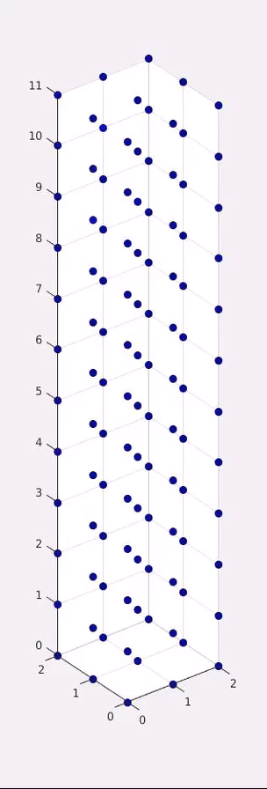
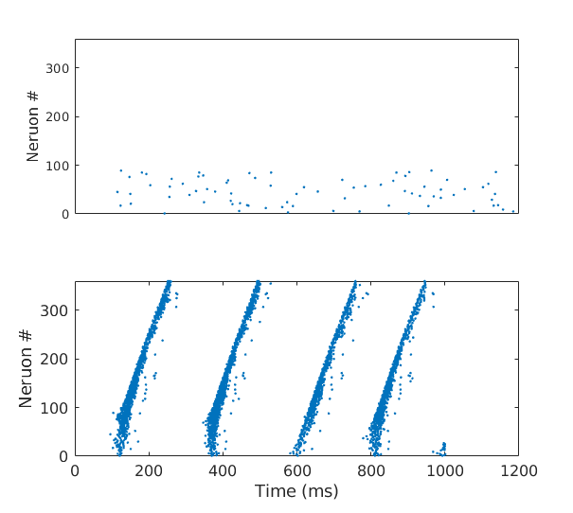
Column simulation
Created column models similar to Maas
Stimulated neurons in bottom 25% with random background, observed wavelike propagation up the column
Demonstrated that the distance-dependent delay can be a critical parameter for synchronized firing with propagation
Column with random propagation delays, no synchronized firing
Identical column with distance-dependent delays, we see synchronized firing that propagates up the column

Slide 11
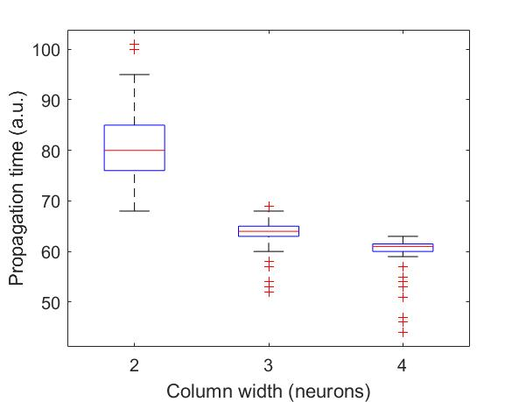
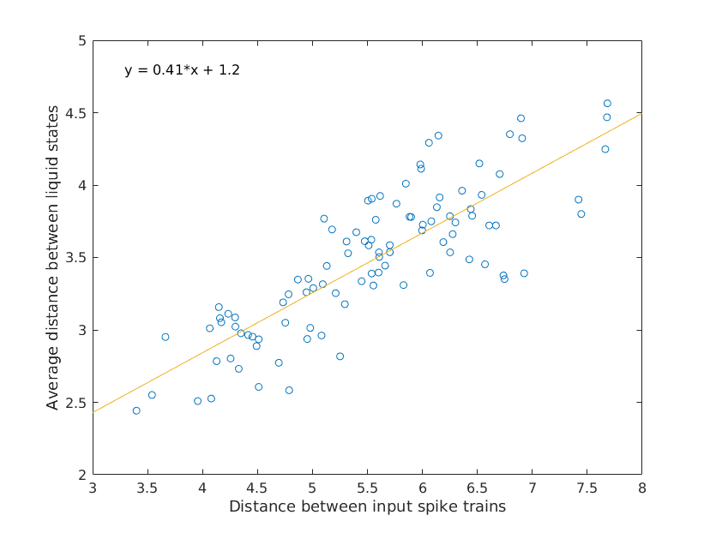
Other results
Neural column width affects effective propagation velocity
Liquid state distance increases with input spike train distance

